Slide 2
develop understanding about the basics of data sufficiency,
analyze steps and strategies for solving data sufficiency questions,
solve various problems relating to data sufficiency.

Slide 3
Basics
Sufficiency
  Statement – Right or True
  Solve Question – Given Statement
Data Sufficiency
  A Question
  Some Statements
  Data - One or More Statements
  Conclude – Data Provided

Slide 4
Steps
Data
  First Statement
  Second Statement
  First & Second Statements
  Answer

Slide 5
Strategies
Understand
  Data Sufficiency Answer Choices
  Statement ‘1’ alone is sufficient to answer the question but statement ‘2’ alone is not sufficient to answer the question.
  Statement ‘2’ alone is sufficient to answer the question but statement 1 alone is not sufficient to answer the question.

Slide 6
Strategies
Understand
  Either of the statements by itself is sufficient to answer the question.
  Statements ‘1’ and ‘2’ taken together are not sufficient to answer the question and requiring more data pertaining to problem.
  Both the statements taken together are sufficient to answer the question but neither of the two statements alone is sufficient to answer the question.

Slide 7
Strategies
Assumptions – Not Allowed
  General Knowledge & Mathematical Principles
    Example - Is Delhi the most populated city in India?
    Statement 1 - The Capital of the India is the most populated city in the India.
    Statement 2 - Delhi is the capital.
    Both the statements taken together are sufficient to answer the question but neither of the two statements alone is sufficient to answer the question.

Slide 8
Strategies
Elimination Method
  Statement ‘1’ (Sufficient)
  Eliminate Choices (Statement ‘1’ Insufficient)
  Statement ‘1’ (Insufficient)
  Eliminate Choices (Statement ‘1’ Sufficient)
  Statement ‘2’ (Sufficient)
  Eliminate Choices (Statement ‘2’ Insufficient)
  Statement ‘2’ (Insufficient)
  Eliminate Choices (Statement ‘2’ Sufficient)

Slide 9
Strategies
Analyze - Sufficiency
  Exact Value - ?
  True/False
  Review
  Enough Information
  Answer
  Conclusion

Slide 10
Problem 1
What marks have been obtained by Arjun?
I. Arjun's marks are the average of marks of Nilesh and Mohit.
II. Nilesh obtained 80 marks, and this is 25% more than the marks obtained by Mohit.
Both the statements taken together are sufficient to answer the question but neither of the two statements alone is sufficient to answer the question.

Slide 11
Problem 1
Explanation
Statement II
  Calculate marks of Mohit.
Statement I
  Arjun's marks = average of marks of Nilesh and Mohit.

Slide 12
Problem 2
What is the three-digit number?
I. Two-fifth of that number is less than half of that number by 20.
II. One-fourth of that number is 25% of that number.
Statement I alone is sufficient to answer the question but statement II alone is not sufficient to answer the question.

Slide 13
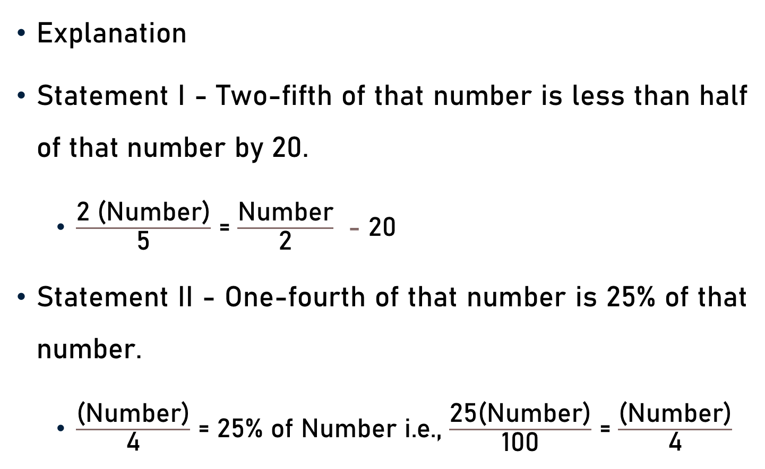
Problem 2
Explanation
Statement I - Two-fifth of that number is less than half of that number by 20.
  $\frac{\text{2}\text{ (}\text{Number}\text{)}}{\text{5}}$ = $\frac{\text{Number}}{\text{2}}$ - 20
Statement II - One-fourth of that number is 25% of that number.
  $\frac{\text{(}\text{Number}\text{)}}{\text{4}}$ = $\text{2}\text{5}\text{\% }\text{of} \text{Number}$ $\text{i}\text{.}\text{e}\text{.,}$ $\frac{\text{2}\text{5(}\text{Number}\text{)}}{\text{100}}$ = $\frac{\text{(}\text{Number}\text{)}}{\text{4}}$
4

Slide 14
Problem 3
What is the ratio between the ages of the father and the son ?
I. The sum of their ages is 50 years.
II. 3 times the sum of their ages is equal to 5 times the father’s age.
Statement II alone is sufficient to answer the question but statement I alone is not sufficient to answer the question.

Slide 15
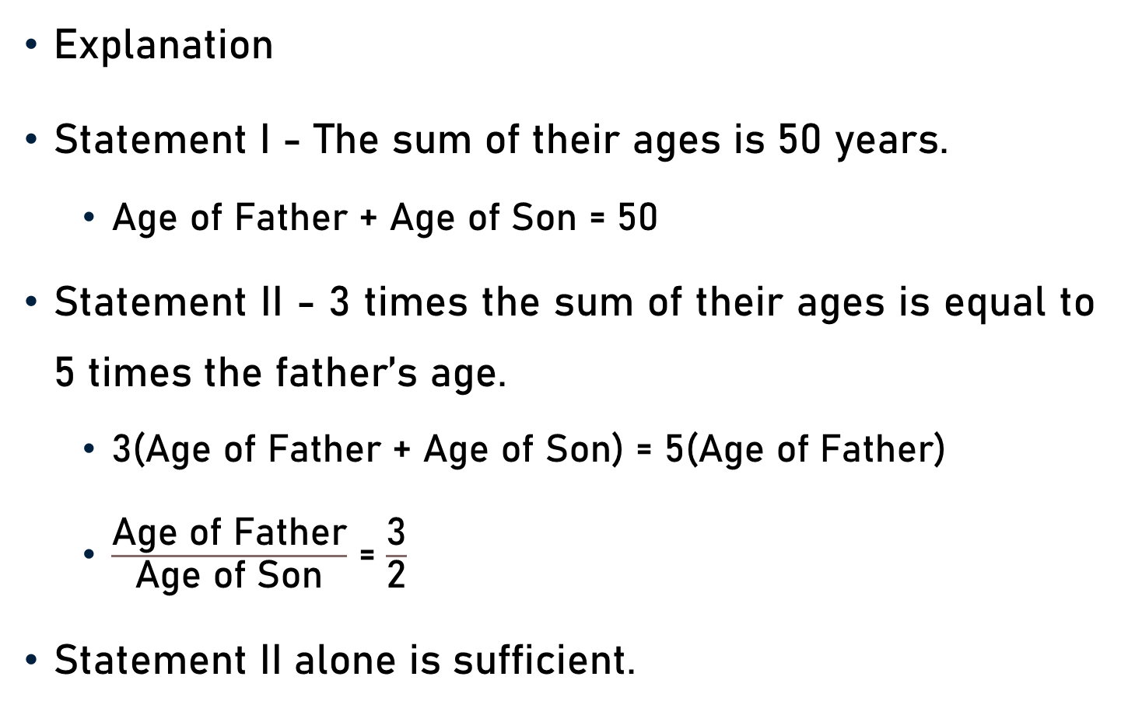
Problem 3
Explanation
Statement I - The sum of their ages is 50 years.
  Age of Father + Age of Son = 50
Statement II - 3 times the sum of their ages is equal to 5 times the father’s age.
  3(Age of Father + Age of Son) = 5(Age of Father)
  $\frac{\text{Age} \text{of} \text{Father}}{\text{Age} \text{of} \text{Son}}$ = $\frac{\text{3}}{\text{2}}$
Statement II alone is sufficient.

Slide 16
Problem 4
Two taps A and B, when opened together, can fill a tank in 6 hours. How long will it take for the pipe A alone to fill the tank?
I. B alone takes 5 hours more than A to fill the tank.
II. The ratio of the time taken by A to that taken by B to fill the tank is 2 : 3.
Either of the statements by itself is sufficient to answer the question.

Slide 17
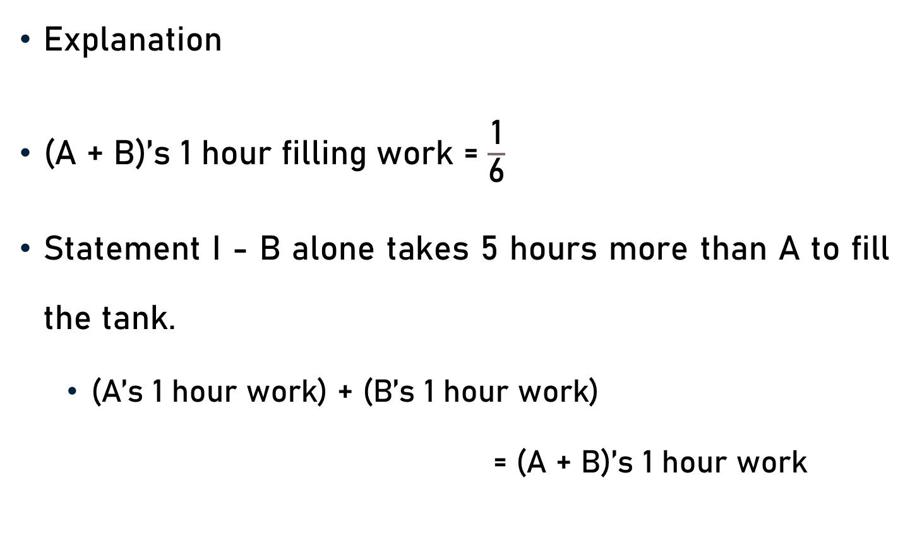
Problem 4
Explanation
(A + B)’s 1 hour filling work = $\frac{\text{1}}{\text{6}}$
Statement I - B alone takes 5 hours more than A to fill the tank.
  (A’s 1 hour work) + (B’s 1 hour work)
  = (A + B)’s 1 hour work

Slide 18
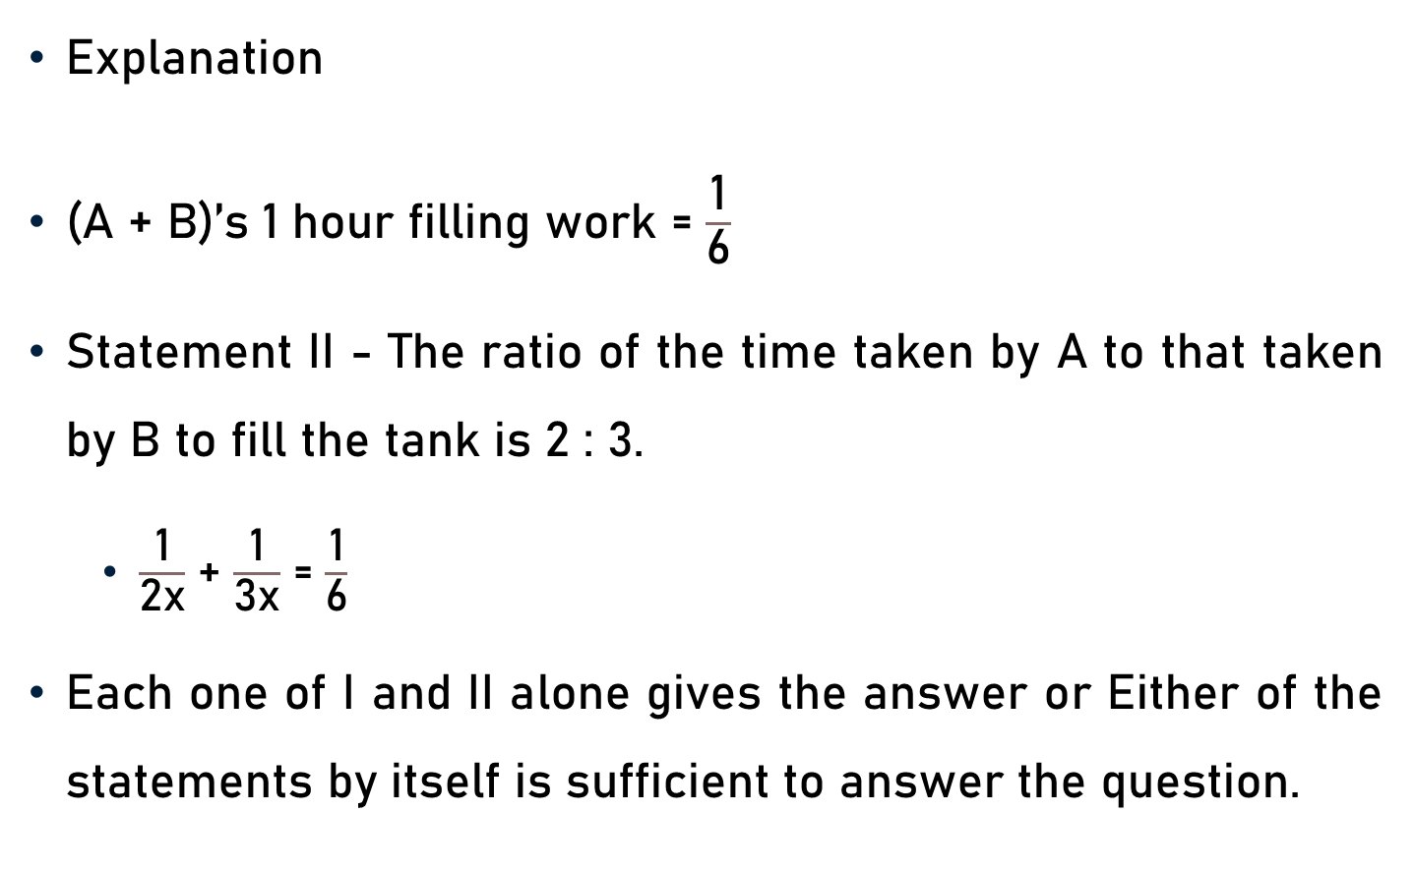
Problem 4
Explanation
(A + B)’s 1 hour filling work = $\frac{\text{1}}{\text{6}}$
Statement II - The ratio of the time taken by A to that taken by B to fill the tank is 2 : 3.
  $\frac{\text{1}}{\text{2}\text{x}}$ + $\frac{\text{1}}{\text{3}\text{x}}$ = $\frac{\text{1}}{\text{6}}$
Each one of I and II alone gives the answer or Either of the statements by itself is sufficient to answer the question.

Slide 19
Problem 5
Shweta walked from her home to the bus stop and back again. How long did it take her to make the entire trip?
I. She walked from home to the bus stop at the rate of 3 km/h.
II. She walked back to home at the rate of 5 km/h.
Statements ‘I’ and ‘II’ taken together are not sufficient to answer the question and requiring more data pertaining to problem.

Slide 20
Problem 5
Explanation
I. She walked from home to the bus stop at the rate of 3 km/hr.
II. She walked back to home @ 5 km/hr
Distance between house and bus stop - not given.
Therefore, the time of trip cannot be calculated.

Slide 21
Problem 6
What is the speed of the current?
I. Speed of the boat is 4 km/hr in still water.
II. The boat runs at a speed of 6 km/hr downstream.
Both the statements taken together are sufficient to answer the question but neither of the two statements alone is sufficient to answer the question.

Slide 22
Problem 6
Explanation
Speed of current/stream = x km/h
I. Speed of the boat is 4 km/hr in still water.
  Speed downstream = (x + 4) km/hr
  Speed upstream = (x – 4) km/hr.

Slide 23
Problem 6
Explanation
II. The boat runs at a speed of 6 km/h downstream.
  x + 4 = 6
  x = 2.
Both the statements taken together are sufficient to answer the question but neither of the two statements alone is sufficient to answer the question.

Slide 24
Problem 7
What is the speed of a running train?
I. The train crosses a signal post in 6 seconds.
II. The train crosses another train running in the opposite direction in 15 seconds.
Statements ‘I’ and ‘II’ taken together are not sufficient to answer the question and requiring more data pertaining to problem.

Slide 25
Problem 7
Explanation
I. The train crosses a signal post in 6 seconds.
II. The train crosses another train running in the opposite direction in 15 seconds.
Lengths of the trains are not given, therefore it is not possible to determine the speed of the train.
Statements ‘I’ and ‘II’ taken together are not sufficient to answer the question and requiring more data pertaining to problem.

Slide 26
Problem 8
What is the rate of interest percent per annum?
I. The amount doubles itself in 10 years.
II. The simple interest accrued in 5 years is Rs. 5000.
Statement I alone is sufficient to answer the question but statement II alone is not sufficient to answer the question.

Slide 27
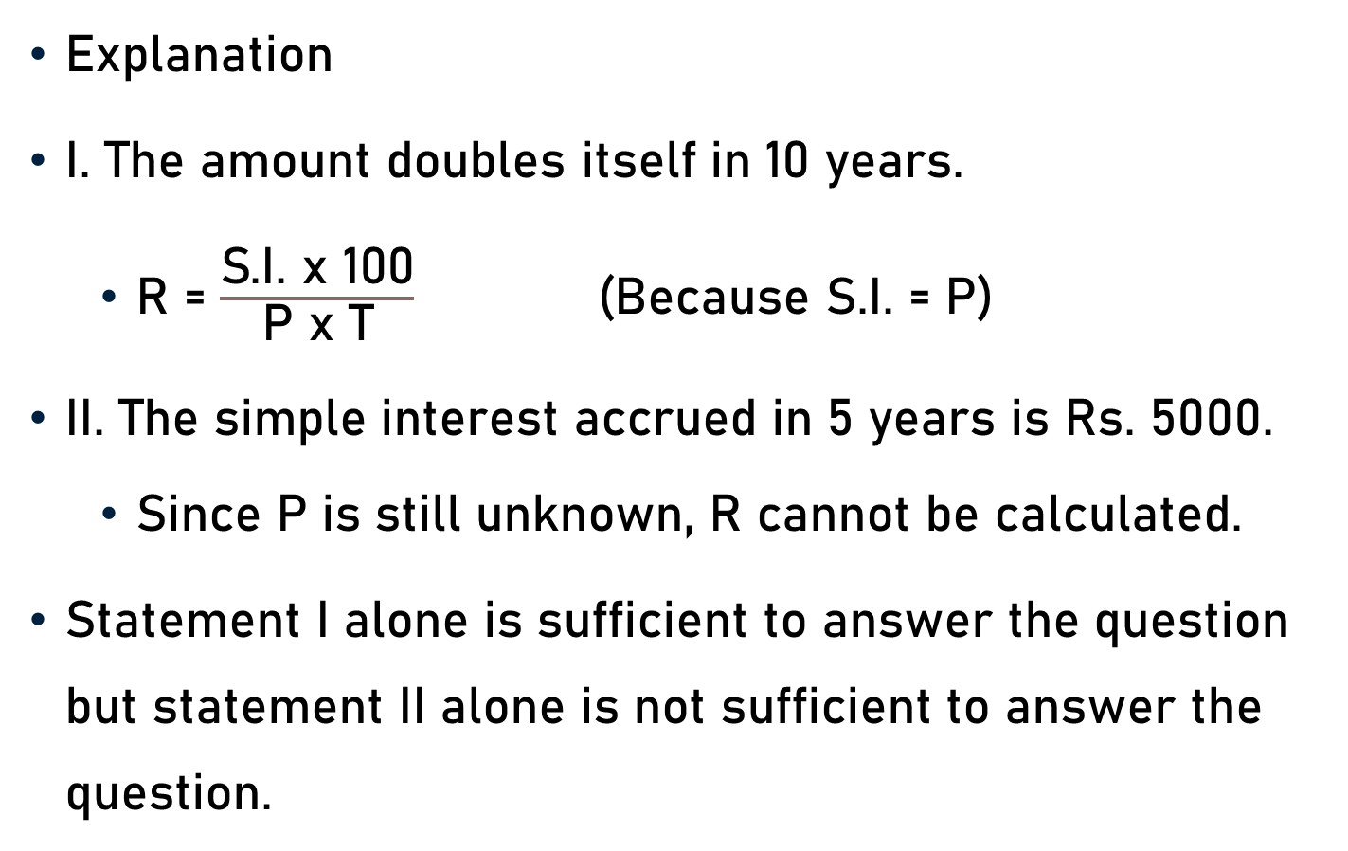
Problem 8
Explanation
I. The amount doubles itself in 10 years.
  R = $\frac{\text{S}\text{.}\text{I}\text{. }\text{x}\text{ 100}}{\text{P} \text{x} \text{T}}$ (Because S.I. = P)
II. The simple interest accrued in 5 years is Rs. 5000.
  Since P is still unknown, R cannot be calculated.
Statement I alone is sufficient to answer the question but statement II alone is not sufficient to answer the question.

Slide 28
Conclusion
Data Sufficiency
  A Question - Some Statements
  Data - One or More Statements
  Conclude – Data Provided

Slide 29
Conclusion
Steps
  First Statement
  Second Statement
  First & Second Statements
  Answer

Slide 30
Conclusion
Strategies
  Understand
  Assumptions – Not Allowed
  Elimination Method
  Analyze Questions

Slide 31
Summary
Data Sufficiency
  Basics
  Steps
  Strategies
  Problems

